Slide 1
Report on United International Yoga Day Sun, 1st July 2018 @ Taman Budaya Reservoir Park, Kuching, Sarawak

Slide 2
Report – United Nations International Day of Yoga
On Sunday, 1st July 2018
At Taman Budaya Resevoir Park, Kuching, Sarawak
Persatuan Brahma Kumaris Malaysia Kuching Branch celebrated UN International Day of Yoga on Sunday, 1st July 2018 at Taman Budaya Reservoir Park, Kuching, Sarawak. This event is supported by the Indian High Commission. The International Day of Yoga aims to raise awareness worldwide of the many benefits of practicing yoga.
We are very fortune to have the Honourable Minister of Tourism, Arts, Culture, Youth and Sports Sarawak, YB Datuk Haji Abdul Karim Rahman Hamzah to officiate the opening of this 4th United Nations International Day of Yoga and to take part in this event.
In the presence of an audience approximately 110, the event commenced with the inauguration of 4th United Nations International Day of Yoga by untangling the ribbon of the appreciation flag led by YB Datuk Haji Abdul Karim Rahma Hamzah followed by Didi Meera Director of Persatuan Brahma Kumaris Malaysia, Dr Muralindran Mariappan, the co-ordinator of Persatuan Brahma Kumaris Malaysia, Kota Kinabalu Branch, Ami Yoga & Studio, Yoga Region, Mr Anderson Voon, CEO of NIIT College Kuching, Brother Chan President of Buddhist Society , key representative of Tusita Hermitage.
This is an outdoor event held at the open space of Taman Budaya Reservoir Park, Kuching. For the first time yoga organisations have gathered to altruistically share their collective intentions in educating the public on the importance of achieving a healthy mind and body through regular practice of Yoga and Meditation.
This event include a continuous guided activity by qualified senior instructors for the participants to experience relaxation postures, yoga postures and breathing by Ami Yoga Studio and Yoga Region, Mr Alvin Heng. Our Honourable Minister and distinguished guests, friends and contacts was given an experience of Hatta Yoga from the floor conducted by yoga instructors. Everyone was enjoyed the demonstration from each of Hatta Yoga groups.
Didi Meera, Director of Persatuan Brahma Kumaris Malaysia, sharing the ultimate connection – Yoga & Unity, that is the theme for this year UN International Day of Yoga. Follow with a silent reflection on Raja Yoga meditation. Distiguished guests, friends, young and old carry with them the deep experience and attainment of inner peace from this 5 minutes meditation with live commentary narrated by Didi Meera.
Thank you Baba, Didi and Honourable Minister of YB Datuk Haji Abdul Karim Hamzah, Mr Anderson Voon, Yoga instructors and all distinguished guests, friends and contacts of your supports to make this event a successful and smoothly one.
OM SHANTI.

Slide 3
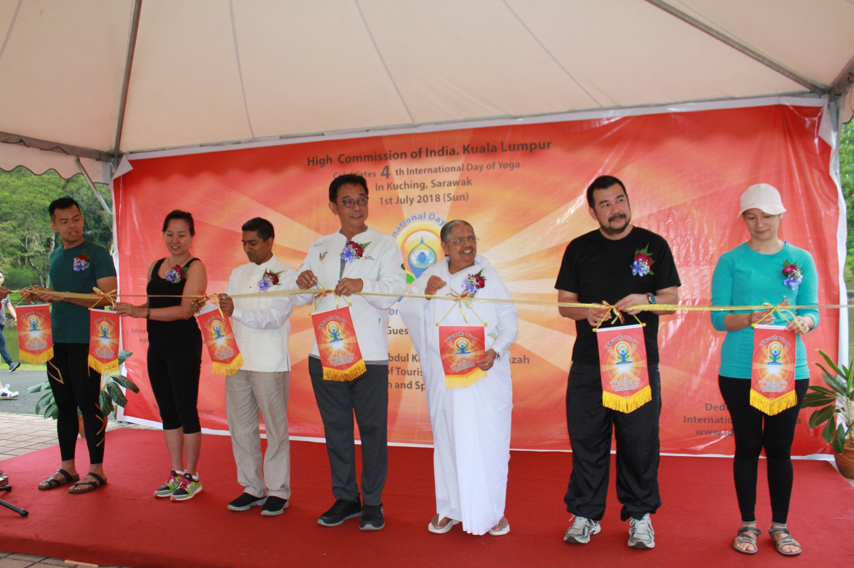
Inauguration of International Yoga Day
Sun, 1st July 2018

Slide 4
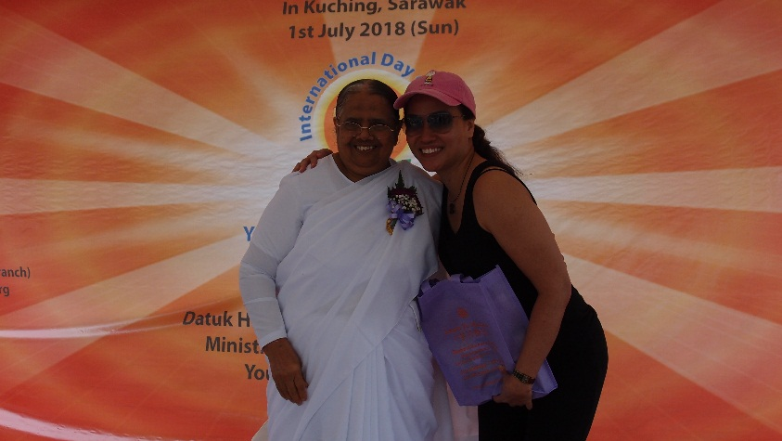
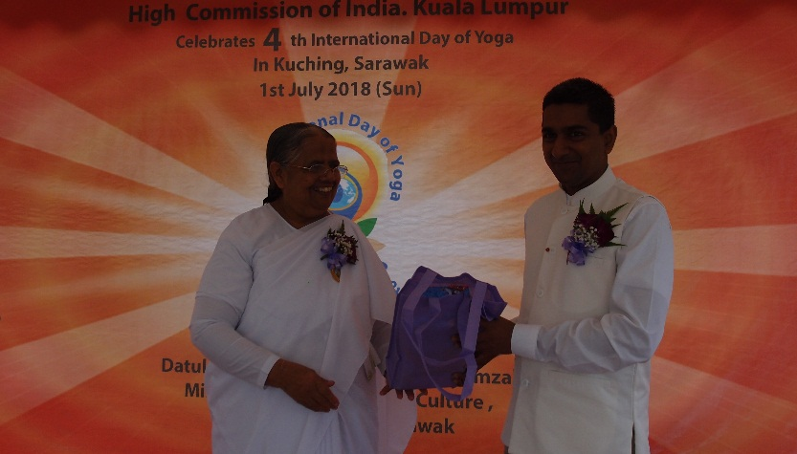
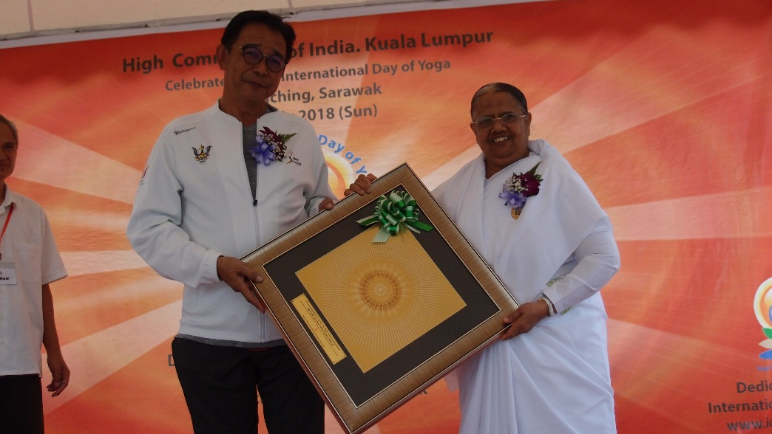
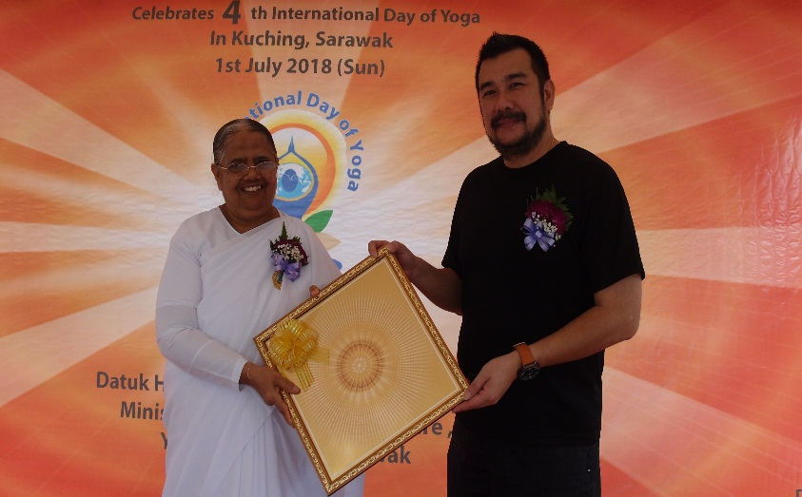
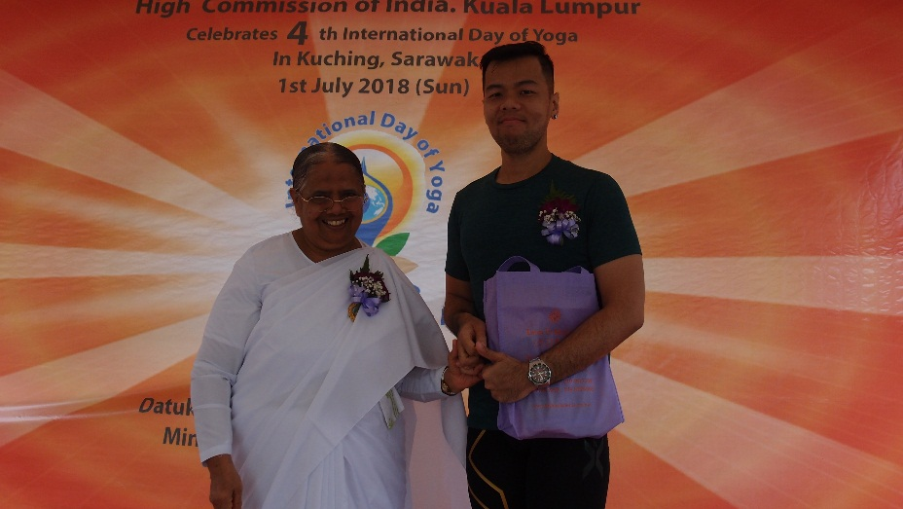
Gift Presentation session

Slide 5
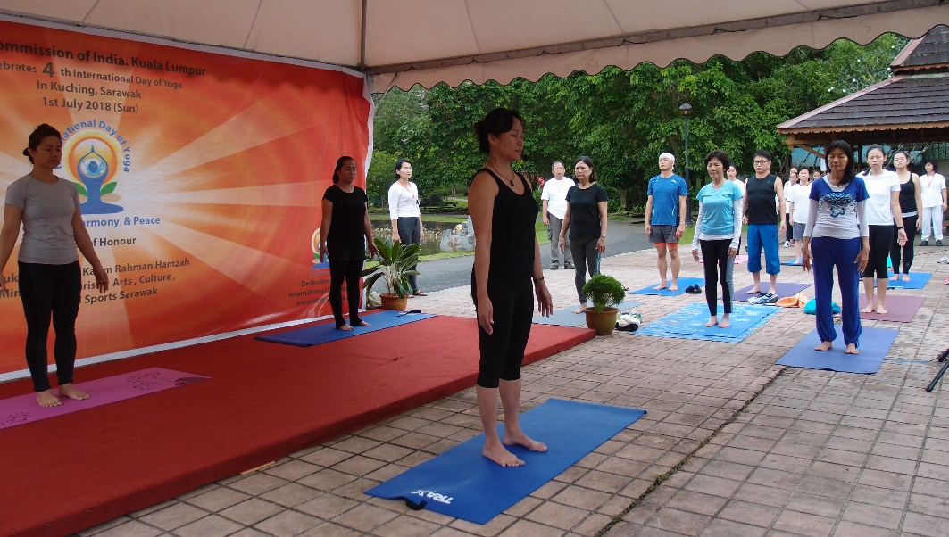
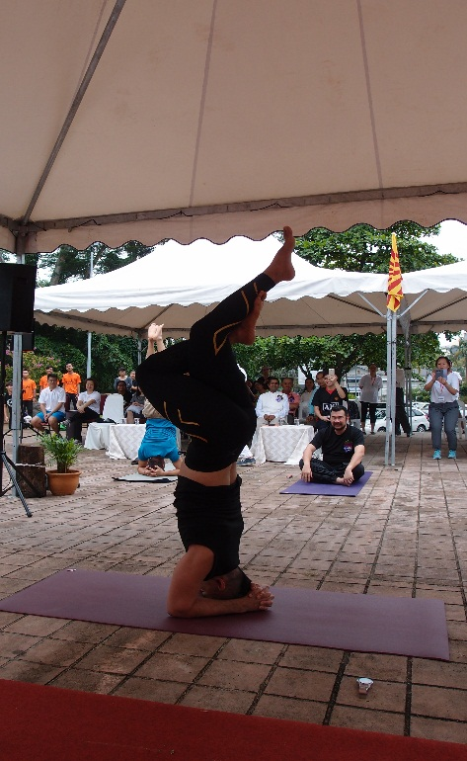
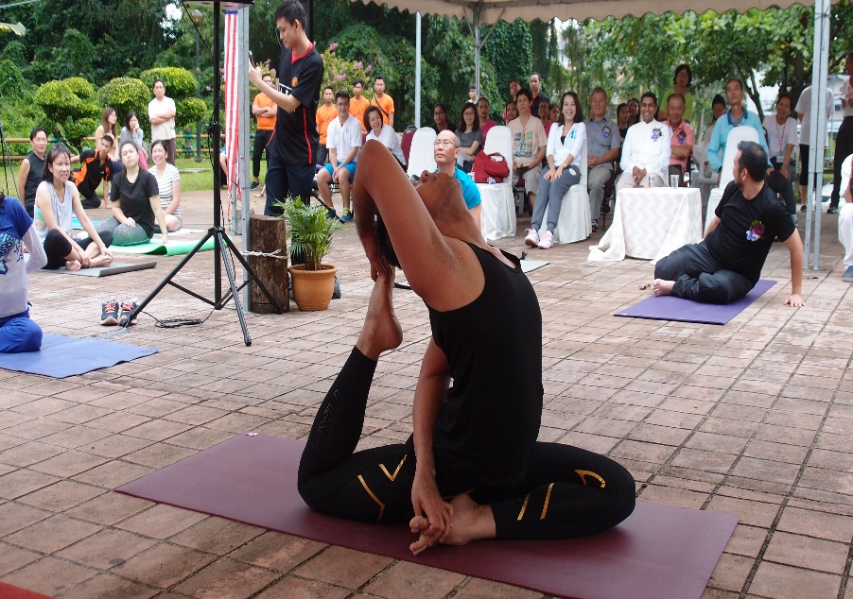
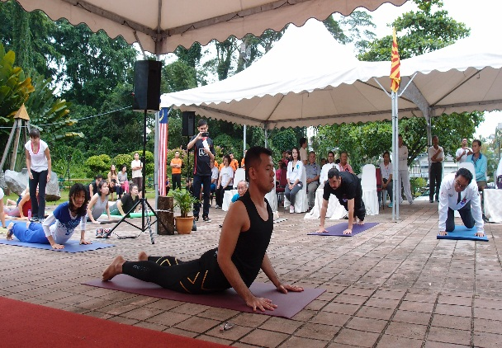
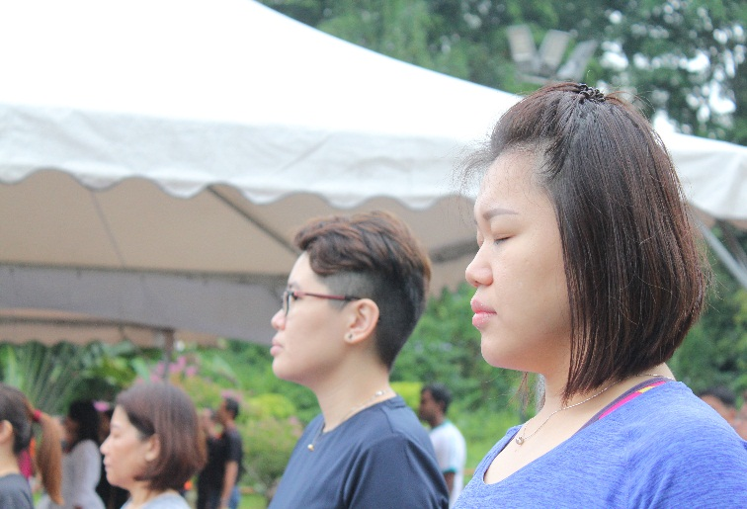
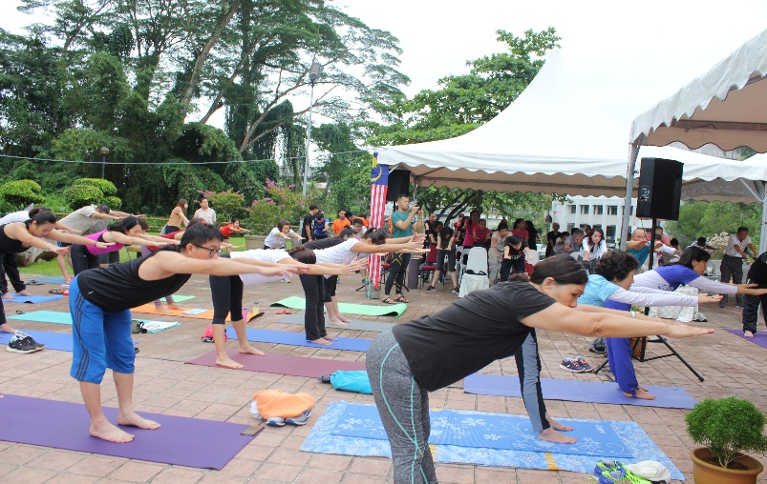
Hatha Yoga
Performance

Slide 6
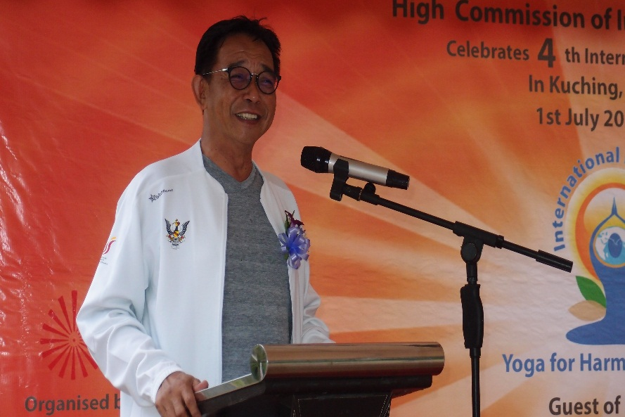
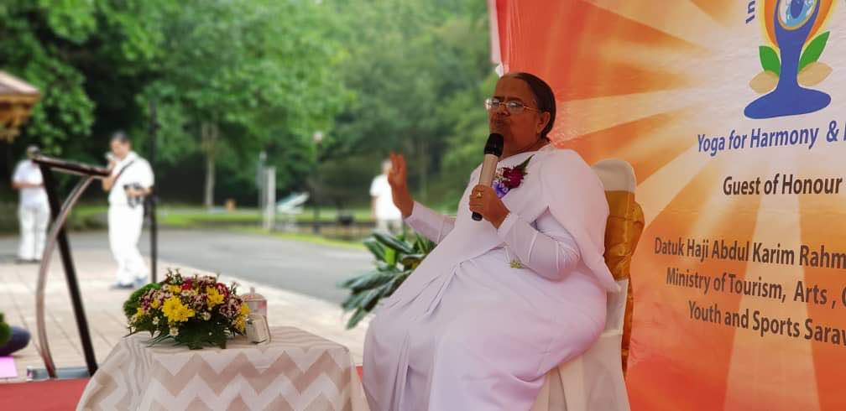
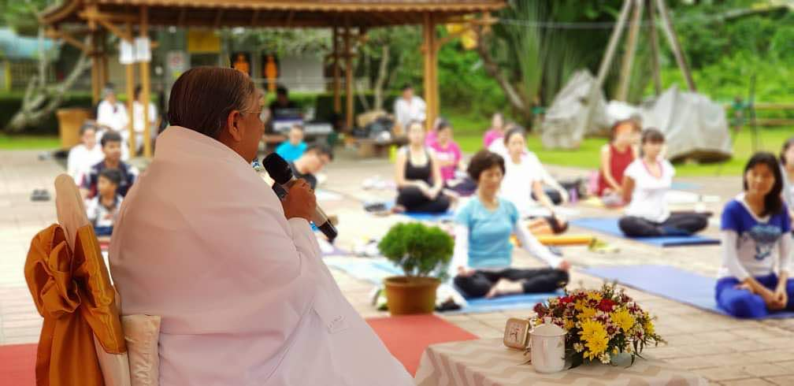
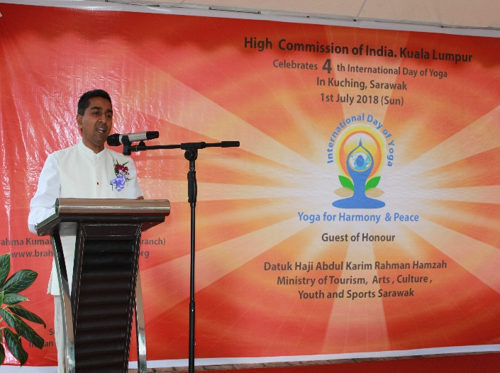
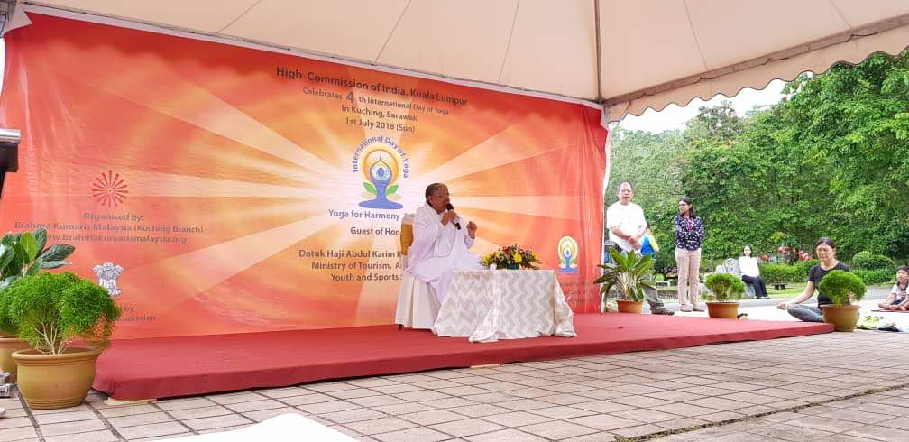
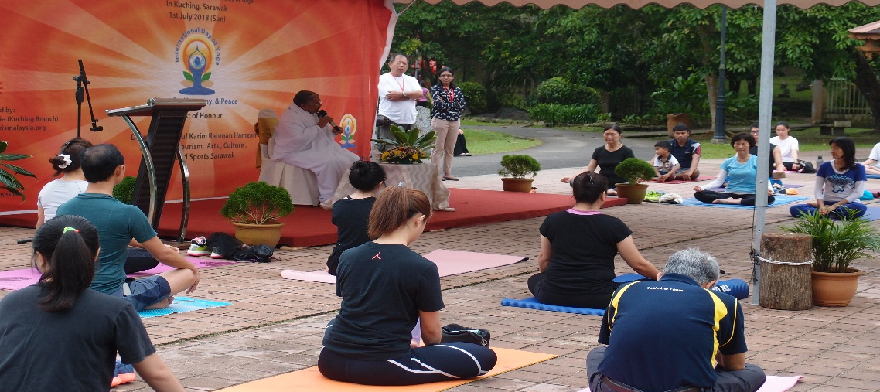
Didi Meera leading
meditation session
Opening speech by Ministry of Tourism, Arts, Culture,
Youth & Sports Sarawak
- YB Datuk Haji Abdul Karim Rahman Hamzah
Dr Murli reads message
By India Prime Minister,
Narendra Modi for
International Yoga Day 2018

Slide 7
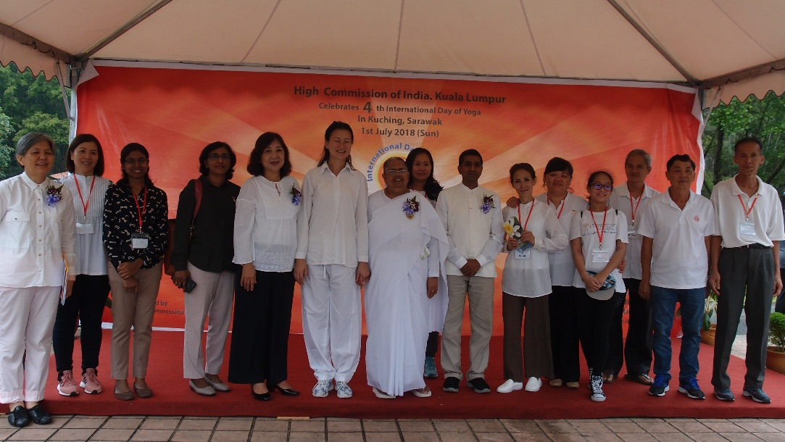
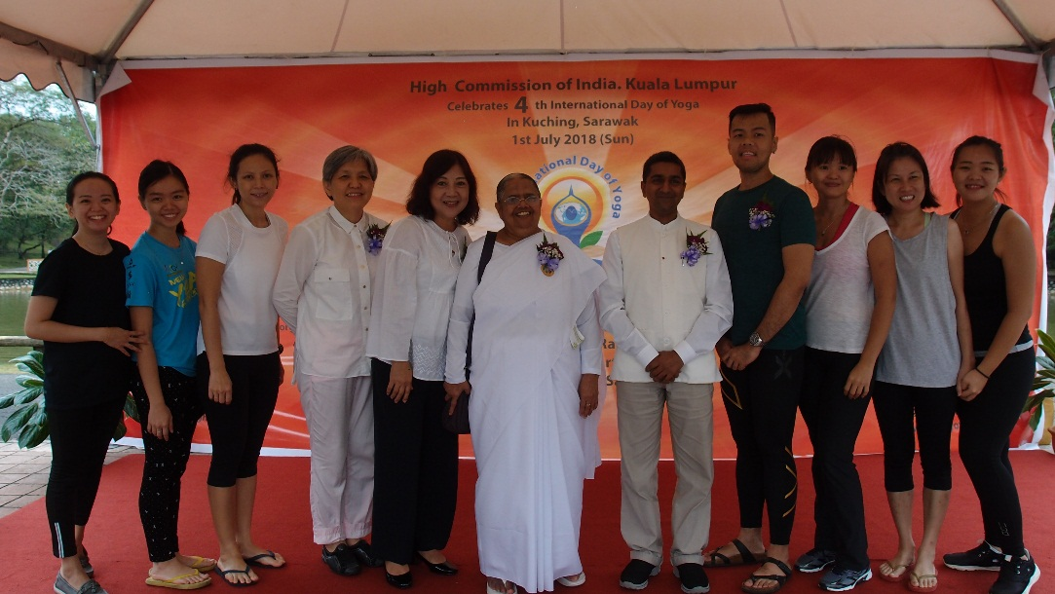
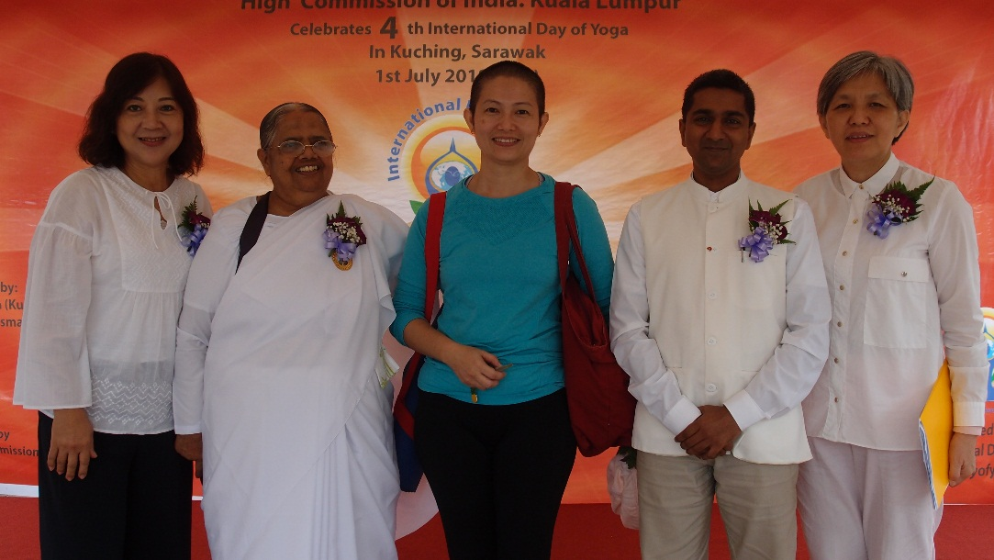
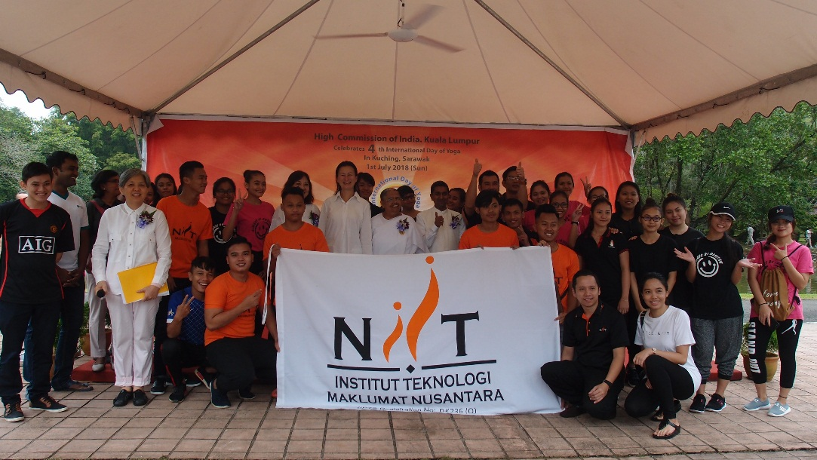
Group Photo with Hatha Yoga Group
Group Photo with Kuching planning team
Group Photo with Tusita Hermitage
Group Photo with NIIT College CEO & students

